Slide 1
Municipal Elections
The Mississippi Secretary of State’s Office
Elections Division
2012

Slide 2
Overview of Training
Miscellaneous
Federal Compliance
Canvassing results
Reporting
Campaign Finance
Absentee Ballots
Affidavit Ballots
Poll Manager Duties

Slide 3
Why are you being trained?
You must be certified to run the election.
You must provide training to the poll workers you hire.

Slide 4
Touch-Screen Voting
You are not required to use any particular type of voting technology.
Touch-screen voting is utilized in federal elections.
You may use any voting method, but your municipality will bear the cost.

Slide 5
Voter Registration
A municipal clerk is still a registrar for voter registration.
Municipalities must coordinate with circuit clerk to have the registered voter put in SEMS.
Effective January 1, 2010, all municipalities must have their voter rolls incorporated into SEMS.

Slide 6
Section 5, Voting Rights Act
Any changes to the elections process must be pre-approved by the U.S. Department of Justice.

Slide 7
Section 5, Voting Rights Act
“It is important to understand that Section 5 applies only to changes in practices or procedures affecting voting. Continuous use of a voting practice in effect since the jurisdiction's coverage date does not implicate Section 5, nor does continued use of a practice already pre-cleared under Section 5.”
(http://www.usdoj.gov/crt/voting/sec_5/types.htm)

Slide 8
US Department of Justice Pre-Clearance
Redistricting
Changing Polling Places
Modifying the Voting Method (e.g., OMR Scanner to Hand Count)

Slide 9
US Department of Justice Pre-Clearance
For more information, please contact:
U.S. Department of Justice, Civil Rights
Division, Voting Section
950 Pennsylvania Ave., NW; Voting Section, NWB; Washington, DC 20530
Phone: (800) 253-3931
Fax: (202) 307-3961

Slide 10
Uniformed and Overseas Citizens Absentee Voting Act (UOCAVA)
Absentee ballots will be received (and cast) by fax or email.
The ballots must be prepared 45 days prior to election.
The ballots must be transmitted 45 days prior to election, if a valid request has been received.
Military personnel will have until 10 days prior to election to register to vote.
Federal Postcard Application
(FPCA)
Federal Write-In Absentee Ballot
(FWAB)

Slide 11
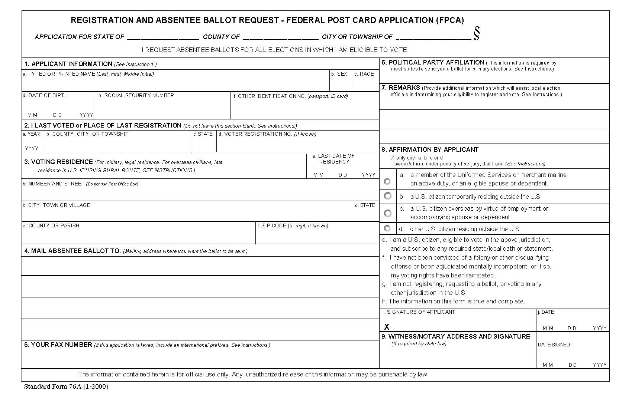

Slide 12
Canvassing Results
The Municipal Election Commission must “canvass” the results of the election.
Canvassing requires accepting or rejecting affidavit ballots.
Canvassing requires verifying the tallying conducted by the poll workers on election day (hand-count jurisdictions).
Reference:
Miss. Code Ann. §23-15-573

Slide 13
Recapitulation
Uniform Reporting
Recapitulation must be completed correctly by Municipal Election Commissioners.
ON-TIME Certification.
Election Commissions have five (5) Days, post-election, to certify properly.
Please forward a copy to Secretary
of State’s Office.

Slide 14
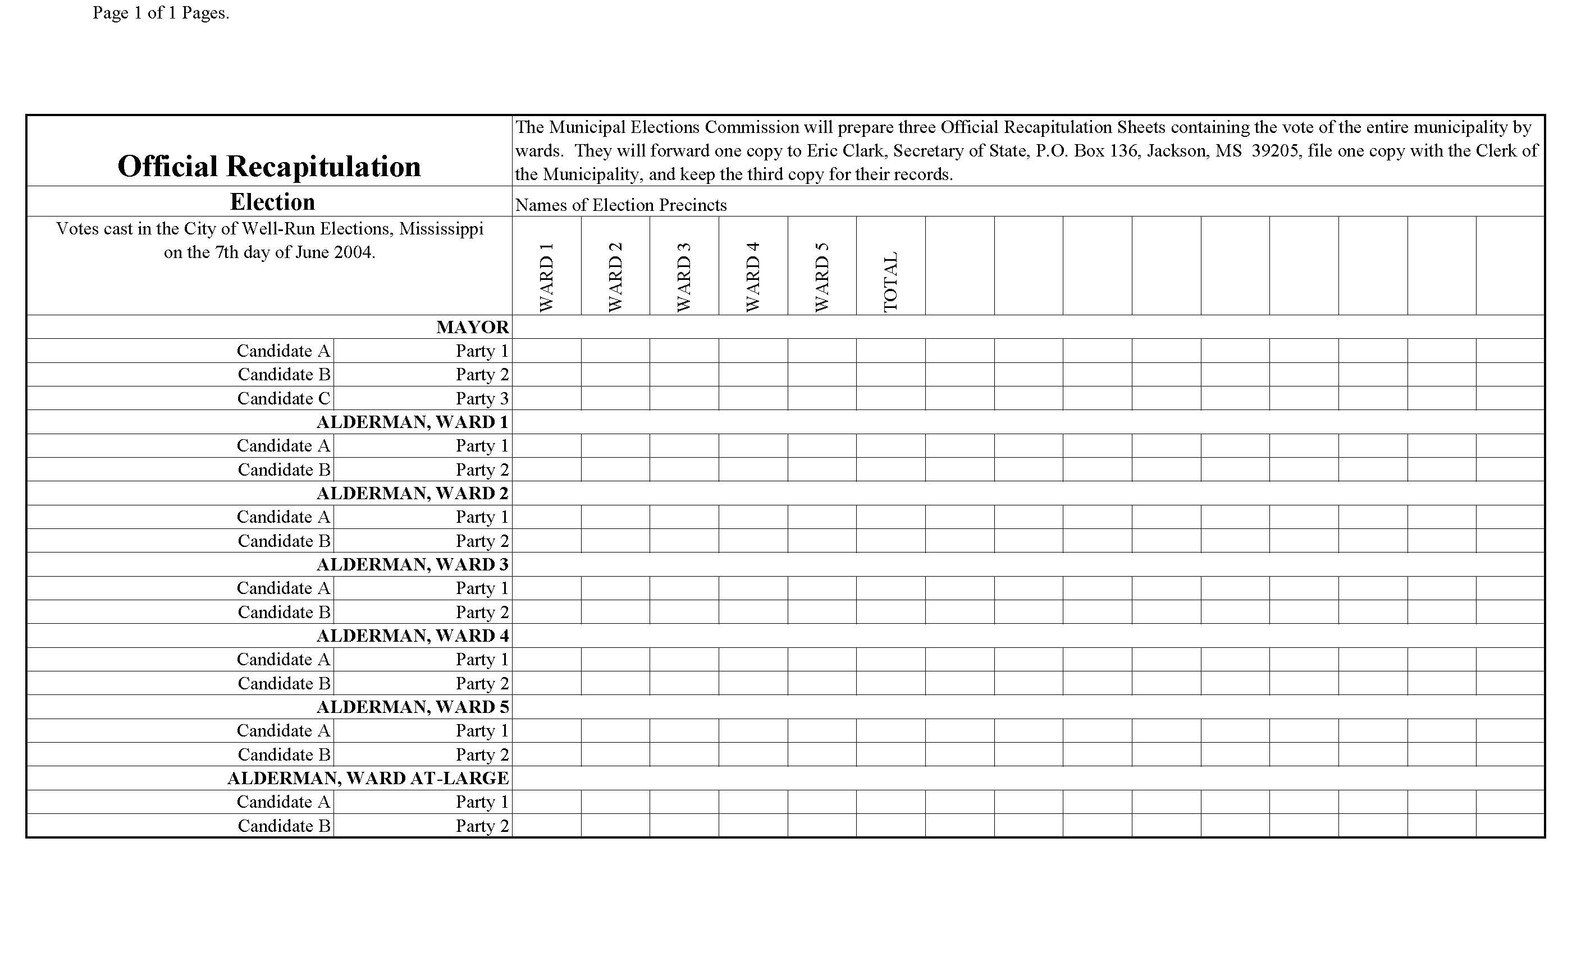

Slide 15
Campaign Finance
Candidate’s campaign finance report MUST be filed prior to taking office.
Candidate’s position will not be certified until their report is filed.
Candidates will not be paid until their report is filed.
All reports must be filed with the Municipal Clerk.
Reference: Miss. Code Ann.
§ 23-15-801 through 23-15-817

Slide 16
Contact Information
The Mississippi Secretary of State’s Office
Elections Division
Heath Hillman, Assistant Secretary of State, Elections
P.O. Box 136
Jackson, MS 39205
Elections Hotline (800) 829-6786
(601) 359-1350
www.sos.ms.gov

