Slide 1
SEMS Introduction
Madalan Lennep, PMP
Election Consultant

Slide 2
Topics to be Covered
I. SEMS Main Screen
II. Election Commissioners Utilization
III. Voter Roll Maintenance
IV. Communication Plan
V. On-Going Support

Slide 3
Topics to be Covered
I. SEMS Main Screen
II. Election Commissioners Utilization
III. Voter Roll Maintenance
IV. Communication Plan
V. On-Going Support

Slide 4
Statewide Elections Management System (SEMS)
Voter Registration - Voter Roll Maintenance
Address Library - Districts and Precincts
Elections Management - Jury Management
Ballot Processing

Slide 5
SEMS Main Screen

Slide 6
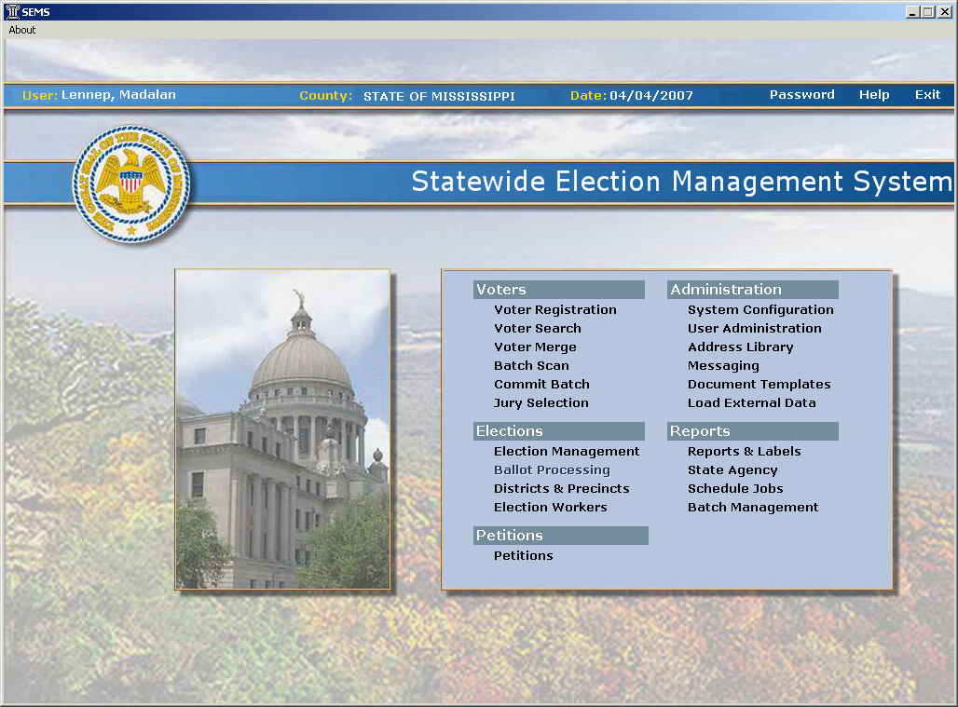

Slide 7
Election Commissioner Utilization
- User name and password will be assigned by Circuit Clerk.
- Utilization is determined by statute
- User rights are determined by profile

Slide 8
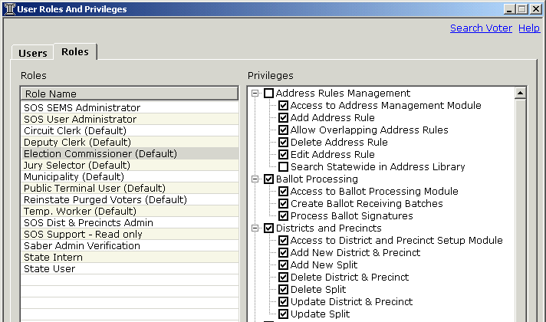

Slide 9
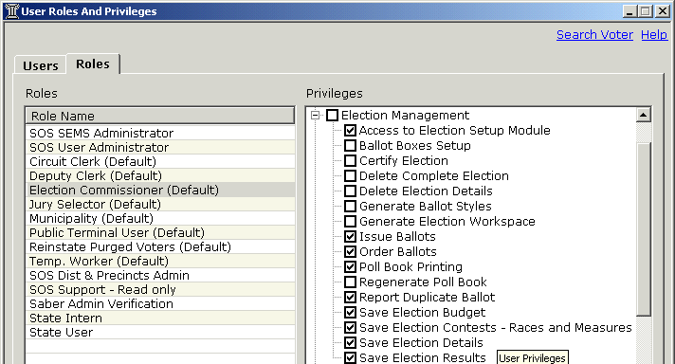

Slide 10
III. Voter Roll Maintenance
Voter Check
Precinct Splits/Districts Check
Other items to check

Slide 11
Voter Check
Duplicate Voters – VR-004
A report that generates a list of possible duplicate voters, at least one of which in each duplicate group has an address in your county.

Slide 12
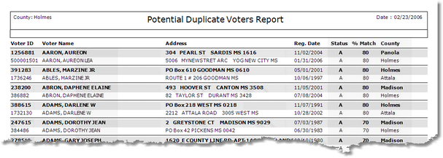

Slide 13
Voter Notification Cards
Seach for voter
Click on Print
Click on Voter Notification Card
Click on Print Now or Print Later

Slide 15
Voter Check – Deceased Voters
Potential Department of Health (DOH) Duplicate Voters Report – VR-022
Lists voters who match persons in the Department of Health (DOH) database of death certificate records. The "% Match" column indicates how close a match the voter (in bold) is with the DOH records, with 100 percent being a perfect match.

Slide 16
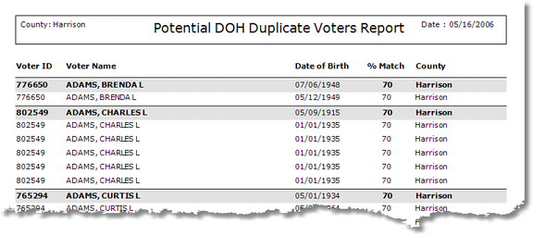

Slide 17
Voter Check – Disenfranchising Crimes
Potential Administrative Office of Courts (AOC) Batch Match – VR-023
Lists voters who match persons in the AOC database of disenfranchising crimes. The "% Match" column indicates how close a match the voter (in bold) is with the AOC counterpart(s), with 100 percent being a perfect match.

Slide 18
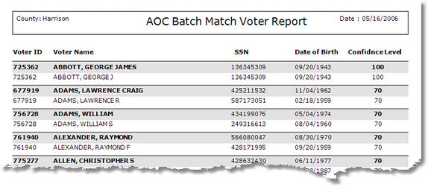

Slide 19
Activity Reporting
Voter Status Summary Report – VR-006
Registrant Activity Report – VR-007
Include in EC meeting minutes.

Slide 20
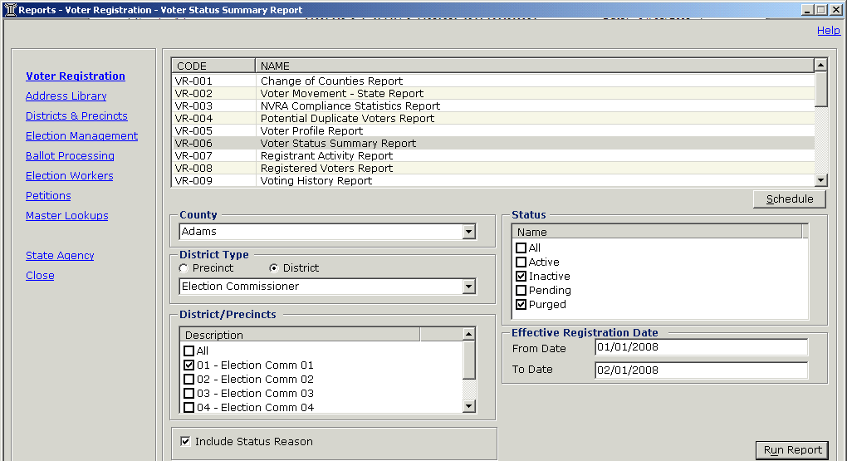

Slide 22
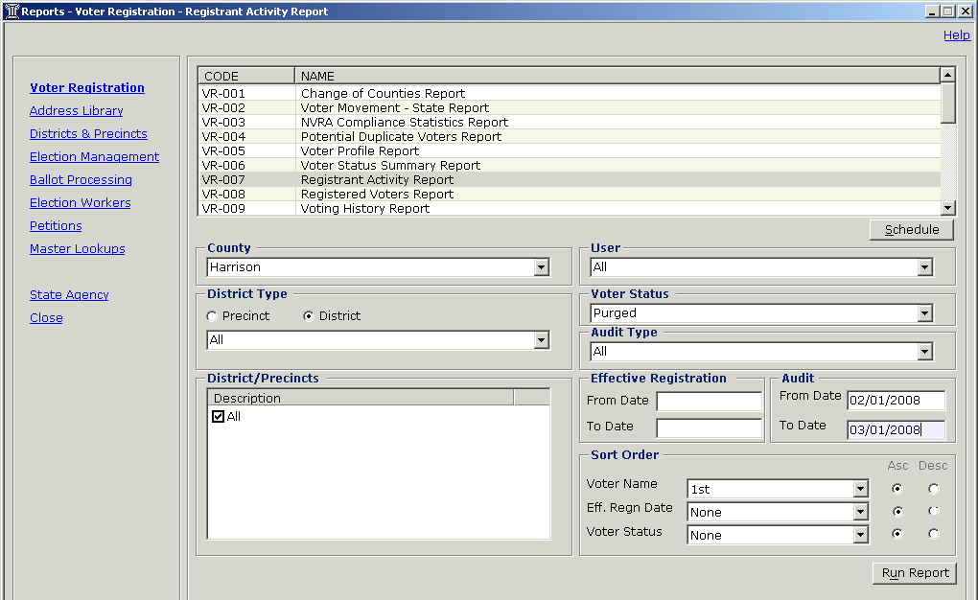

Slide 24
Precinct Check
Precinct Split Voter Count – DP-007
Lists voter counts by split with subtotals for each precinct.

Slide 25
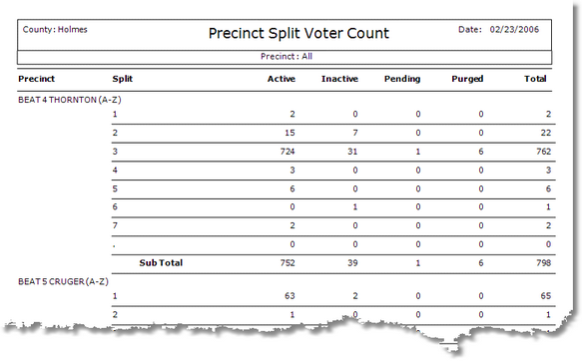

Slide 26
Districts Check
Districts Within Precincts – DP-012
Breaks down each selected precinct by split and shows all of the currently associated voting districts for each split.

Slide 27
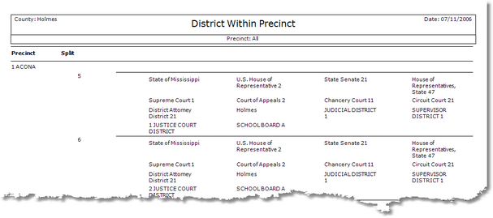

Slide 28
IV. Communication Plan
Email address for each election commissioner
County Conference calls
SEMS Help Desk/Review by SEMS Focus Group
Election Officials web page and Secure Site

Slide 29
V. On-Going Support
Help Desk support and monitoring
GoToMeeting SEMS web-based training
Focus Group review of enhancements
Hands on training opportunities

Slide 30
Basic SEMS Training
w/Absentee Processing
Redistricting Training
Election Operations
GEMS Database Build
Train-the-Trainer

Slide 31
Questions /Answers

Slide 32
SEMS Support Center
1-877-357-SEMS (7367)
sems.support@sos.ms.gov
Madalan Lennep
Charlie Case
Shequita Lowe
Stephanie McCann
Antonio Sudduth
Matthew Summerlin

