Slide 1
Mississippi Secretary of State’s Office
Online Voter
Registration Overview
October 30, 2014

Slide 2
Online Voter Registration
Fast and easy method to register to vote or to update an existing registration
Application transmitted electronically
Can be available on smart phones and other mobile devices
Signature obtained from driver’s license/state identification database

Slide 3
Online Voter Registration
States with Online Voter Registration:
Arizona (2002)
Washington (2007)
Kansas (2009)
Colorado (2010)
Indiana (2010)
Louisiana (2010)
Oregon (2010)
Utah (2010)
New York (2011)
California (2012)
Maryland (2012)
Nevada (2012)
Nevada (2012)
South Carolina (2012)
Virginia (2013)
Connecticut (2014)
Delaware (2014)
Georgia (2014)
Illinois (2014)
Missouri (2014)
Hawaii (passed 2012)
Massachusetts (passed 2014)
Nebraska (passed 2014)
West Virginia (passed 2013)

Slide 4
Limited Online Registration:
Michigan
New Mexico
Ohio

Slide 5
Cost and Savings
Average cost is $250,000 to $750,000
Built internally or contracted
Features
Kansas and California
Arizona savings:
83 cents for paper registration
3 cents for online registration
California savings of approximately $2.34 per online registration

Slide 6
Voter Roll Accuracy
Less data entry errors
Identity information verified before processing
Easier for voters to update information

Slide 7
Online Voter Registration System
Signature requirement
No match or no signature available
Process very similar to paper registrations

Slide 8
Security
Not directly connected to voter roll database
Multiple screens
No unnecessary personal information
Data encryption and data logs
Minimum time
Only state to report any issues is Washington
General website security; no issues with registrations

Slide 11
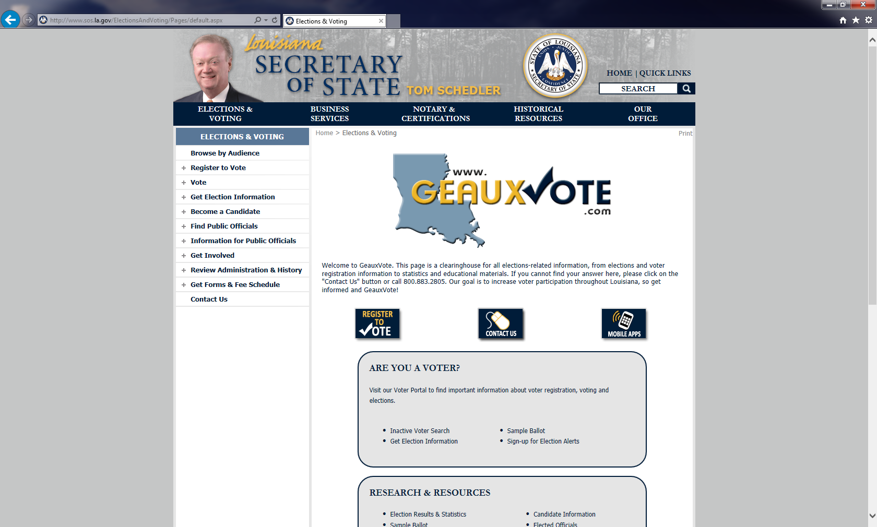

Slide 12
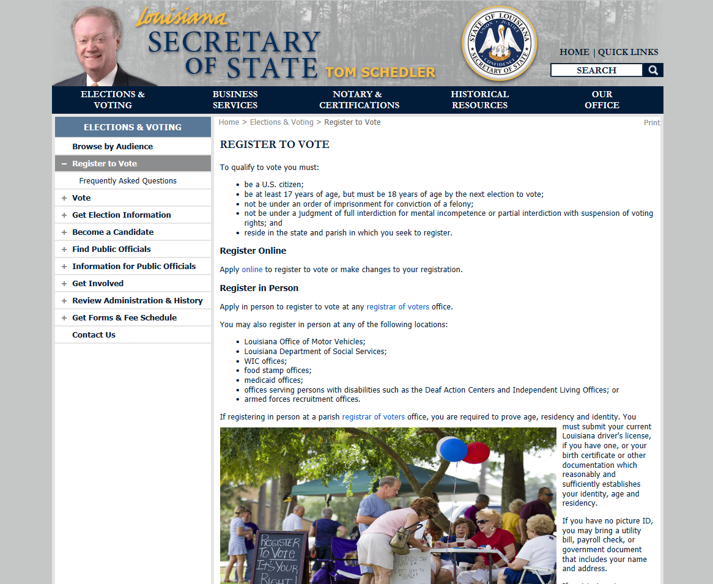

Slide 13
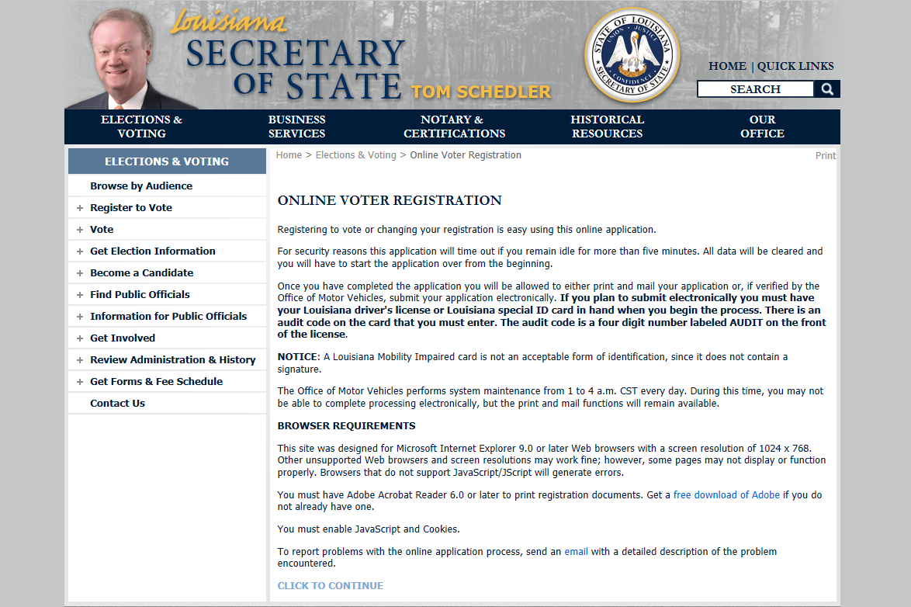

Slide 15
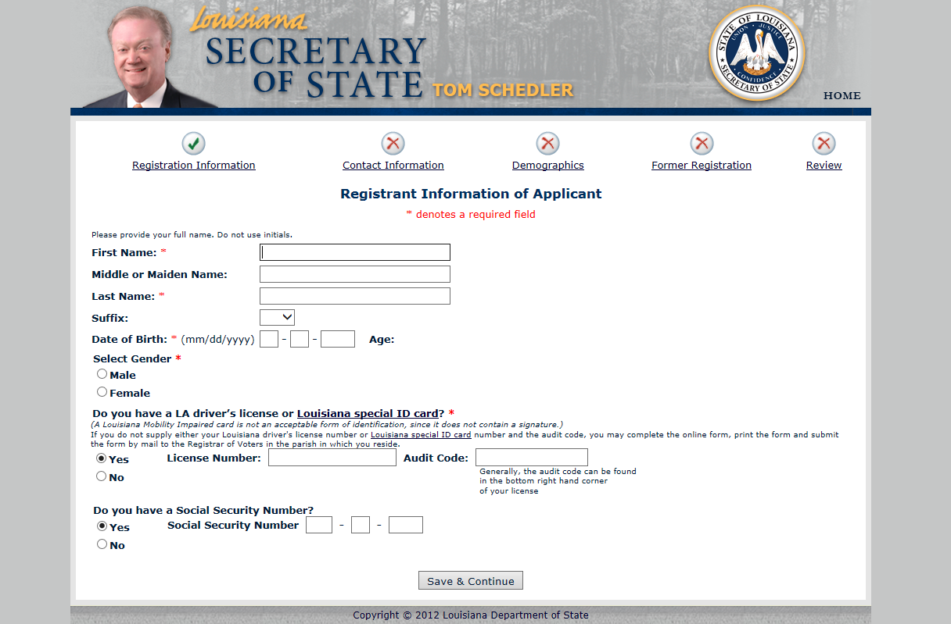

Slide 17
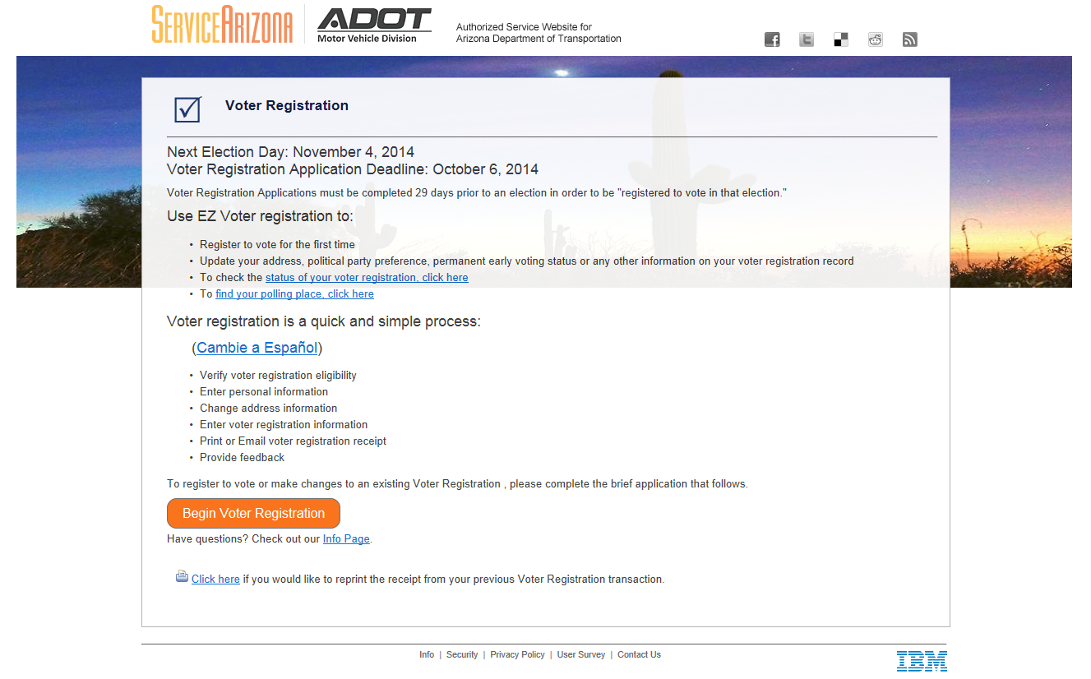

Slide 18
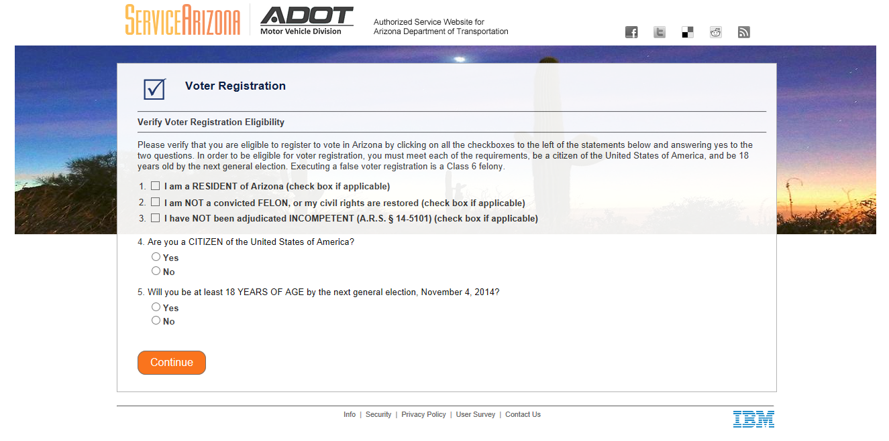

Slide 20
Discussion & Questions
For more information, contact:
Policy & Research Division
601-359-1621
www.sos.ms.gov

