Slide 1
Mississippi Secretary of State’s Office
Out-of-Precinct Voting
A Look at Mississippi’s Absentee Voting and the Emergence of Early Voting
Kim Turner, Assistant Secretary of State of Elections
Prepared for the Study Group to Review Mississippi Election Laws
October 1, 2014

Slide 2
Classes of Out-of-Precinct Voting
ABSENTEE VOTING
47 states and the District of Columbia
20 states require an excuse, reason or justification to vote by absentee ballot
27 states and the District of Columbia permit any qualified voter to vote by absentee ballot without an excuse, reason or justification
EARLY VOTING
33 states and the District of Columbia
VOTING BY MAIL
3 states (Oregon, Washington and Colorado)
19 additional states conduct certain elections entirely by mail

Slide 3
Absentee VOTING
Out-of-Precinct Voting

Slide 4
Absentee Voting
Eligible voters must complete an application to receive an absentee ballot.
Application and absentee ballot may be provided to and returned by the voter by mail,
Application and absentee ballot may be provided to and returned by the voter in-person.
Permanent absentee ballot list: once a voter is added to the list, he/she automatically receives an absentee ballot in all future elections.

Slide 5
MISSISSIPPI
Absentee Voting; Excuse Required

Slide 6
Mississippi Absentee Voting
Registered voters may cast an absentee ballot
Beginning forty-five (45) days prior to election day,
By first completing an application therefor,
Marking a reason for voting by an absentee ballot,
In person in the Circuit Clerk’s Office located in the voter’s county of residence, or
By mail, email or fax, if eligible.

Slide 7
Application for an Absentee Ballot
Each County Circuit Clerk is responsible for providing an absentee ballot application to an eligible voter beginning sixty (60) days prior to an election day
Upon the written or oral request of the voter,
Upon the written or oral request of the voter’s parent, child, spouse, sibling, legal guardian, or those empowered with a power of attorney for that voter.

Slide 8
Application for an Absentee Ballot
The voter must sign the application.
An official authorized to administer oaths, such as a Circuit Clerk or Notary Public, must acknowledge the voter’s signature.
Exceptions include the application of a voter with a temporary or permanent physical disability, which must be witnessed by a person 18 years of age or older, and the Federal Post Card Application, which requires neither a witness nor acknowledgment.

Slide 9
Federal Post Card Application
The Federal Post Card Application (“FPCA”) may be submitted by absent voters as defined by the Uniformed and Oversea Citizen Absentee Voting Act (“UOCAVA”):
Enlisted or commissioned member of any component of the Armed Forces, spouse or dependent of such member,
Member of the Merchant Marines or American Red Cross, spouse or dependent of such member,
Disabled war veteran who is a patient in any hospital, spouse or dependent of such veteran,
Civilian attached to and serving outside of the United States with any branch of the Armed Forces, the Merchant Marines, or American Red Cross, spouse or dependent of such civilian, or
Citizen of Mississippi temporarily residing outside territorial limits of United States and the District of Columbia, spouse or dependent if also absent from the county of his/her voting residence on election day.
The FPCA is available and may be completed on-line and submitted to the Circuit Clerk in the county of the voter’s residence by mail, e-mail or fax.
The FPCA may be electronically signed by the voter and requires no acknowledgement or witness signature.
A UOCAVA voter may register to vote simultaneous with requesting an absentee ballot by submitting the FPCA to the Circuit Clerk in the county of the voter’s residence within ten (10) days prior to an election day.
One (1) FPCA acts as a continuing request for an absentee ballot for one (1) calendar year.

Slide 10
Reasons to Cast an Absentee Ballot In-Person
Enlisted or commissioned member of any component of the Armed Forces, spouse or dependent of such member,
Member of the Merchant Marines or American Red Cross, spouse or dependent of such member,
Disabled war veteran who is a patient in any hospital, spouse or dependent of such veteran,
Civilian attached to and serving outside of the United States with any branch of the Armed Forces, the Merchant Marines, or American Red Cross, spouse or dependent of such civilian,
Citizen of Mississippi temporarily residing outside territorial limits of United States and the District of Columbia, spouse or dependent if also absent from the county of his/her voting residence on election day,
Student, teacher or administrator whose employment or studies necessitate his/her absence from his/her county of voting residence, spouse or dependent who maintains a common domicile outside the county of voting residence,
Person who will be outside his/her county of residence on election day,
Person required to be at work on election day during the times at which the polls will be open,
Person who have a temporary or permanent physical disability,
Member of the Mississippi Congressional delegation, spouse or dependent of such member,
Parent, spouse or dependent of a person having a temporary or permanent physical disability who is hospitalized outside his/her county of residence or more than 50 miles away from his/her residence who will be with such person on election day,
Trained or certified emergency response provider deployed during the absentee voting period on election day or during any state of emergency,
Citizen of Mississippi enrolled as a student at a United States Military Academy, spouse or dependent of such student, or
Person sixty-five (65) years of age or older.

Slide 11
In-Person Absentee Voting
In the Circuit Clerk’s Office located in the voter’s county of residence.
Beginning 45 days prior to election day and continuing until 12:00 p.m. on the Saturday before a Tuesday election day.
The County Circuit Clerks’ Office must remain open from 8:00 a.m. until 12:00 p.m. on the two (2) Saturdays preceding an election day for absentee voting.
The County Circuit Clerk or deputy clerk may acknowledge the absentee ballot application as well as the absentee ballot envelope.

Slide 12
Reasons to Cast an Absentee Ballot by Mail
Person who has a temporary or permanent physical disability,
Parent, spouse or dependent of a person having a temporary or permanent physical disability who is hospitalized outside his/her county of residence or more than 50 miles away from his/her residence who will be with such person on election day,
Person sixty-five (65) years of age or older,
Mississippi resident temporarily residing outside his/her county of voting residence,
Enlisted or commissioned member of any component of the Armed Forces, spouse or dependent of such member,
Member of the Merchant Marines or American Red Cross, spouse or dependent of such member,
Disabled war veteran who is a patient in any hospital, spouse or dependent of such veteran,
Civilian attached to and serving outside of the United States with any branch of the Armed Forces, the Merchant Marines, or American Red Cross, spouse or dependent of such civilian,
Citizen of Mississippi temporarily residing outside territorial limits of United States and the District of Columbia, spouse or dependent if also absent from the county of his/her voting residence on election day,
Citizen of Mississippi enrolled as a student at a United States Military Academy, spouse or dependent of such student, or
Trained or certified emergency response provider deployed during the absentee voting period on election day or during any state of emergency.

Slide 13
By-Mail Absentee Voting
A voter casting an absentee ballot by mail must first receive, complete and return an application therefor by mail to the Circuit Clerk located in the voter’s county of residence.
In addition to the application, the signature of the voter on the absentee ballot envelope must be acknowledged by an official authorized to administer oaths.
Exceptions include the absentee ballot envelope of a UOCAVA voter and a voter with a temporary or permanent physical disability.
Absentee ballots returned by mail must be received by the Circuit Clerk by 5:00 p.m. the day before an election day.

Slide 14
Absentee Voting by E-mail or Fax
Eligible voters include:
Enlisted or commissioned member of any component of the Armed Forces, spouse or dependent of such member,
Member of the Merchant Marines or American Red Cross, spouse or dependent of such member,
Disabled war veteran who is a patient in any hospital, spouse or dependent of such veteran,
Civilian attached to and serving outside of the United States with any branch of the Armed Forces, the Merchant Marines, or American Red Cross, spouse or dependent of such civilian,
Citizen of Mississippi temporarily residing outside territorial limits of United States and the District of Columbia, spouse or dependent if also absent from the county of his/her voting residence on election day,
Citizen of Mississippi enrolled as a student at a United States Military Academy, spouse or dependent of such student, or
Trained or certified emergency response provider deployed during the absentee voting period on election day or during any state of emergency.
Absentee ballots returned by UOCAVA voters by e-mail or fax must be received by the Circuit Clerk located in the voter’s county of residence by 7:00 p.m. on election day.

Slide 15
Permanently Disabled List
If the application of a person who is permanently disabled is accompanied by a statement signed by physician, or nurse practitioner, which indicates the voter is permanently physically disabled to such a degree it is difficult for him/her to vote in person, then such voter is entitled to automatically receive an absentee ballot for all elections on a continuing basis without need for reapplication.

Slide 16
Absentee Voting – 2012 General Election
Of the 1,905,605 active voters in the State of Mississippi, 5.60% or 106,722 voters cast an absentee ballot in the November 6, 2012 Election. Seven (7) counties reported greater than 10% of its active voters casting an absentee ballot, for an average of 10.82%:
County | Active Voters | Ballots Rec’d | Percentage
Claiborne County | 8,093 | 934 | 11.54%
Greene County | 8,099 | 829 | 10.24%
Grenada County | 16,963 | 1,800 | 10.61%
Jefferson County | 6,129 | 682 | 11.13%
Noxubee County | 9,332 | 940 | 10.07%
Quitman County | 5,571 | 660 | 11.85%
Winston County | 13,446 | 1,381 | 10.27%

Slide 17
Absentee Voting – 2011 General
In comparison, thirteen (13) counties reported greater than 10% of its active voters casting an absentee ballot in the 2011 General Election, for an average of 12.6%. Those counties with the highest percentages included:
Claiborne County, 17.2%
Quitman County, 14.6%
Tunica County, 14.0%
Benton County, 13.9%
Noxubee County, 13.9%
Jefferson County, 13.6%

Slide 18
early Voting
Out-of-Precinct Voting

Slide 19
Absentee Early Voting
Term often used to encompass three (3) forms of balloting:
Early In Person Voting,
No Excuse Absentee Voting,
Permanent Absentee Voting, and
Vote by Mail.

Slide 20
Early Voting (2014)
Notes:
Blue depicts the early voting states. Orange depicts the all-mail states. Green depicts early voting and no-excuse absentee voting states. Gray depicts no early voting; excuse/reason/justification required to vote by absentee ballot.

Slide 21
Early Voting
Early voting allows voters to visit an election officials’ office or, in some states, other satellite voting locations, and cast a vote in person without offering an excuse for why the voter is unable to vote on election day.
Use of satellite voting locations vary by state
Time period for early voting varies by state
Average starting time for early voting is 22 days before the election
Early voting periods range in length from 4 days to 45 days; the average across all states is 19 days

Slide 22
No Excuse Absentee Voting
No excuse absentee voting is conducted by mail-in paper ballot prior to election day.
States typically require a voter to complete an application to receive an absentee ballot.
Applications may be available on-line for voters to print and send
Applications may be entirely submitted online
Florida, Louisiana, Maryland, Minnesota and Utah
Notes:
The category of absentee voting includes “no excuse” and “excuse required” voting. While the distinction between early voting and absentee voting appears to be the manner by which the absentee ballot is delivered to the voter, i.e., absentee voting by mail versus early voting in person, some states, like Mississippi, allow for absentee voting by mail and in-person.
Arguably, all out-of-precinct voting may be described as absentee voting, with early voting, no excuse absentee voting and vote-by-mail included therein as subcategories.

Slide 23
Permanent Absentee Voting
Voters may join a permanent absentee voting list, which entitles the voter to automatically receive an absentee ballot for all future elections.
Arizona, California, District of Columbia, Hawaii, Montana, New Jersey and Utah
8 states, including Mississippi, offer permanent absentee status to a limited number of voters who meet certain criteria
Kansas, Massachusetts, Minnesota, Mississippi, Missouri and West Virginia offer this option based upon permanent disability or illness of the voter

Slide 24
Vote-by-Mail
An absentee ballot is automatically mailed to every eligible voter approximately two (2)weeks before election day. Ballots may be returned via mail or dropped off at satellite locations or county elections’ offices.
No request or application by the voter is necessary
Oregon, Washington and Colorado conduct all elections by mail

Slide 25
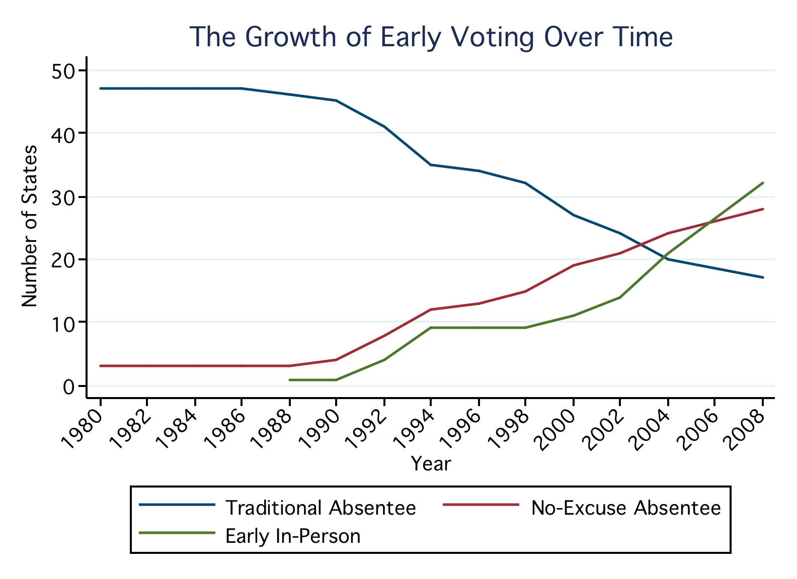
Reform (1980-2008)

Slide 26
Growth of Early Voting
In 2012, approximately 33% of all ballots cast during the Presidential Election were cast early.
In comparison, 5.60% or 106,722 of Mississippi voters cast an absentee ballot in the 2012 Presidential Election, and approximately 4.46% or 18,036 Mississippi voters cast an absentee ballot in the 2014 Primary Election.

Slide 27
Possible Advantages of Early Voting
Voter Convenience and Satisfaction
Financial Savings to the State/County
Added Avenues to Mobilize Voters
Increased Efficiency in the Precincts on Election Day
Increased Voter Participation
At this time, studies do not yet show a marked increase in turnout in larger general elections
Notes:
Some argue that early voting is a negative; others that is a positive. For election administrators, early voting has reduced management pressures on Election Day, but has likely increased costs and created new administrative burdens. For candidates, early voting has created new avenues to mobilize voters, but has made campaigns more expensive. For voters, it has made casting a ballot easier and more convenient.

Slide 28
Possible Disadvantages of Early Voting
Security/ Voter Fraud and Intimidation
Voter Education
Increase in Residual Votes
Weeks-Long Election “Day”
Financial Considerations
Added paper costs associated with ballots and administrative costs
Breaking with Tradition
Civic Experience
Research indicates voters prefer voting in a manner that is familiar.

Slide 29
Considerations
Time period; beginning when and continuing for how many days before an election day?
In-person and/or by-mail?
Limited to the Circuit Clerks’ Offices or use of additional satellite locations?
Entirely paper ballot or use of voting machines?
Means by which to ensure ballot security and absence of voter fraud and intimidation.

